Slide 1

Investment for mortgage-back securities
By Adrian Sealy

Slide 2




Summary
Business objectives
Hypotheses
Data/methods
Results/recommendations

Slide 3
Business objectives
How to allocate dollars earmarked for investment into mortgage-back securities
Investigate the factors that drive home prices
What different independent variables influence the average sale prices of houses in Ames city?

Slide 4
Hypotheses
H1: When looking at the mean of sale prices between neighborhoods there isn’t a significant difference between Northridge Heights and College Creek
Ha: There is a significant difference between the mean of sale prices between Northridge Heights and College Creek
H2: The mean of sale prices of houses built and remodeled >= 2000 (Year) = the mean sale prices of the houses built < 2000 and remodeled >= 2000
Ha: The mean of sale prices of the houses built and remodeled >= 2000 is <> the mean of sale prices of the houses built < 2000 and remodeled >= 2000

Slide 5
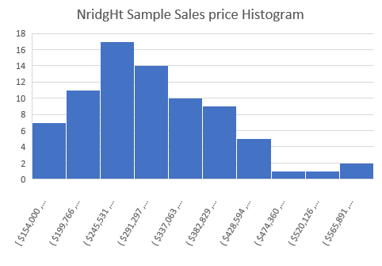
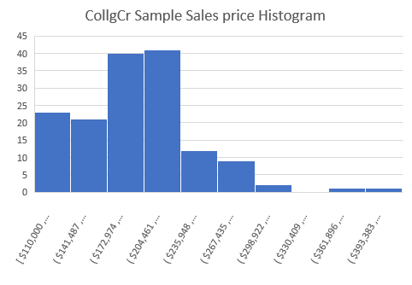
Neighborhood Data
By neighborhood we’re looking at Northridge Heights (NridgHt) and College Creek (CollgCr) with the sum of sale prices
Data for both neighborhoods are roughly normally distributed and show 30+ observations
Data was collected from houses sold between January of 2006 to July of 2010
Obtained a total of 227 samples

Slide 6
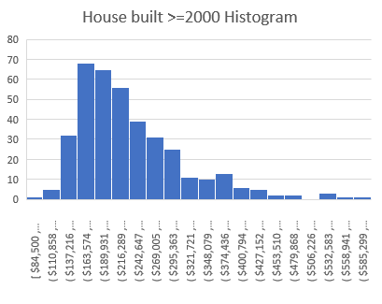
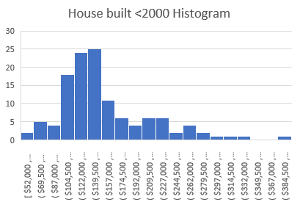
Year Built and Year Remodeled Data
What the two samples have shared are house styles of one story (1 story) and two-story (2 story). Also, years remodeled being from 2000-2010.
What’s different is one sample contained houses built after 2000 and the other sample contained houses built before 2000.
Both samples were roughly normally distributed and have 30+ observations
Total of 499 samples between both populations

Slide 7
Methods
Used an independent two tailed t-test for H1 and H2 by using excel’s pivot table filtering and analysis ToolPak
Used visualizations to enhance understanding of the C.I. lower and Upper limit found from the t-test

Slide 8
Results from H1
The p-value of 8.07705E-17 is less than the alpha of 0.05, which tells us there is a significant difference between the neighborhoods
This leads to the rejection of the null hypothesis
There is a 95% confidence the difference in means of sales price between the samples is between $94,972 and $141,638

Slide 9
Results from H2
The p-value of 2.13975E-27 is less than our alpha of 0.05, which tells us to reject the null hypothesis
The mean of sale prices of the houses built and remodeled after 2000 is greater
95% confident the difference between the sample means is between $-6,679.37 and $20,476.38

Slide 10



Recommendations
Based on the results of the t-tests I would recommend investing in neighborhoods with high average sale prices and houses built after 1999
When planning investments neighborhood selection is an important factor
College Creek has a higher total sum, but Northridge Heights has a higher average
Even with a remodel, houses built after 2000 will be a more desirable choice to place investments

